Slide 1
Time to Jump to zyBooks – Chapter 2

Slide 2
Variables and Expressions
Section 2.1 Variables and Assignments
zyBooks Lab – in class activities
What is a variable?
In a program, a variable is a named item, such as x or num_people, that holds a value.
What is an expression?
An assignment statement's left side must be a variable. The right side can be an expression, y = x + 2
Which are valid assignment statements?
Participation 2.1.3
Write the code for Assigning a sum
Challenge Activity 2.1.2

Slide 3
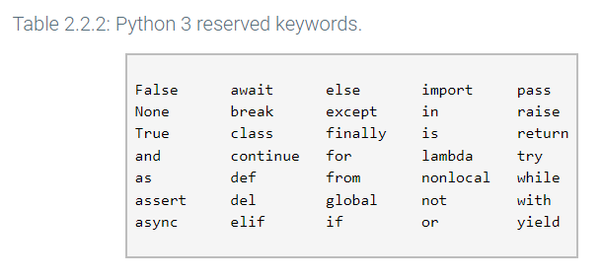
Variables and Expressions
2.2 Identifiers
What is an identifier?
Name to the variables, functions etc.
Can an identifier start with an underscore?
Yes, specifically used for private function and variables
Is python case sensitive?
Yes
What are “reserved words” or “keywords”
Zybooks in class activities

Slide 4
Variables and Expressions
2.3 Objects
What is an “object”?
An object represents a value and is automatically created by the interpreter when executing a line of code. For example, executing x = 4 creates a new object to represent the value 4.
Does the Python interpreter or the programmer generate objects?
Participation Activity 2.3.1
What does the term “garbage collection” mean?
The automatic process that deletes unused objects.
What is name binding?
The process of associating names with interpreter objects. 2.3.2
What are the 3 properties of a Python object?
value, type, identity (A unique identifier that describes the object.)
What does the Python function type() do?
What does the Python function id() do? (Virtual memory address)
Zybooks in class activities

Slide 5
Variables and Expressions
2.4 Numeric Types: Floating-point
What is a float-type object?
A floating-point number is a real number, like 98.6, -0.0001
What is the range of a floating-point object when you have a 32-bit installation of Python?
For a standard 32-bit installation of Python, the maximum floating-point value is approximately 1.8x10³⁰⁸, and the minimum floating-point value is 2.3x10⁻³⁰⁸
What is an OverflowError?
Why do we have to be careful of Overflow errors? Overflow occurs when a value is too large to be stored in the memory allocated by the interpreter.
When should you use the float type?
When should you use the integer type?
Participation activity 2.4.2
What does the following statement mean?
print(f'{myFloat:.2f}’)
The f-string syntax in Python allows you to format strings using variables and expressions.
Zybooks in class activities

Slide 6
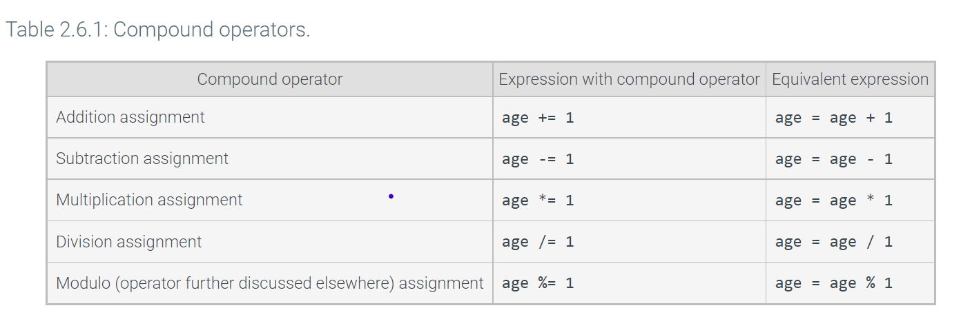
Variables and Expressions
2.5 Arithmetic Expressions
What is a unary minus? Converts positive to negative value
Why is it good practice to put a “space” around “operators” y = x + 1
What is a compound operator?
Are commas allowed in integer or float literals? No
Zybooks in class activities

Slide 7
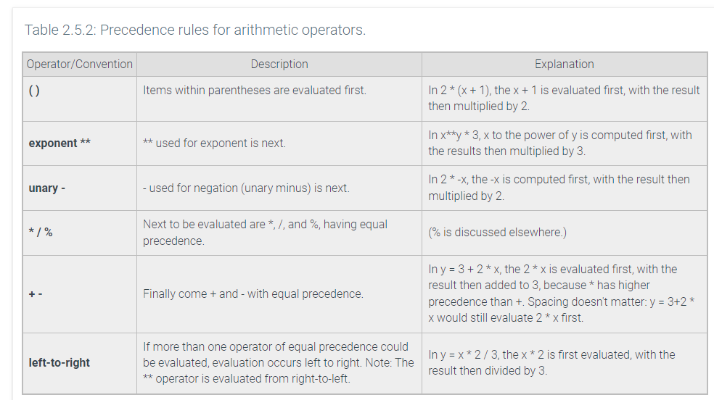
Variables and Expressions
2.5 Arithmetic expressions
Zybooks in class activities
Participation Activity 2.5.1
Participation Activity 2.5.2

Slide 8
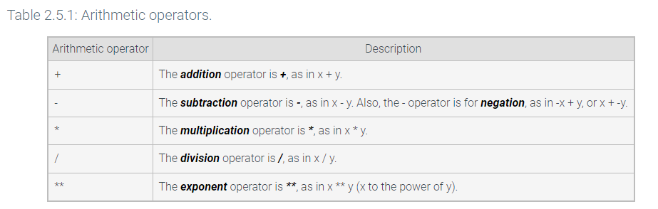
Variables and Expressions
2.6 python Expressions
What is a literal? a = 1 b = “1” c = True
What is an operator?
An operator is a symbol that performs a built-in calculation
What is an expression in Python?
An expression is a combination of items, like variables, literals, operators, and parentheses
Zybooks in class activities

Slide 9
Variables and Expressions
2.6 python expressions
Zybooks in class activities
Challenge Activity 2.6.1
Challenge Activity 2.6.2
Challenge Activity 2.6.3

Slide 10
Variables and Expressions
2.7 Division and modulo
Zybooks in class activities
What type does the division operator return? floating-point
What is the value returned by 5/10?
What is a floored division operator?
What is the value returned by 5//10?
Can you divide by 0 in python?
What symbol is used to denote the “modulo” operation?
What is the value of 24 % 10?
Participation Activity 2.7.3

Slide 11
Variables and Expressions
2.8 Module basics
Zybooks in class activities
What is a script? Your code.
How do you invoke a script?
What is a module?
A file containing Python code that can be used by other modules or scripts.
How do you reference code that is in another module?
How do you reference an object that is referenced in an imported module? Dot file_name.contends
Participation Activity 2.8.2

Slide 12
Variables and Expressions
2.8 Module basics
Zybooks in class activities
When does the imported module get executed? import
What does the built-in special name “__name__” do?
determine if the file was executed as a script by the programmer or imported by another module.
Participation Activity 2.8.4

Slide 13
Variables and Expressions
2.9 Math Module
Zybooks in class activities
What is the math module?
To support advanced math operations.
How do you use/invoke the math module?
Math.
What is a function?
A function is a list of statements that can be executed simply by referring to the function's name.
What is an argument to a function? The item passed to a function
How do you make a function call? Invoke

Slide 14
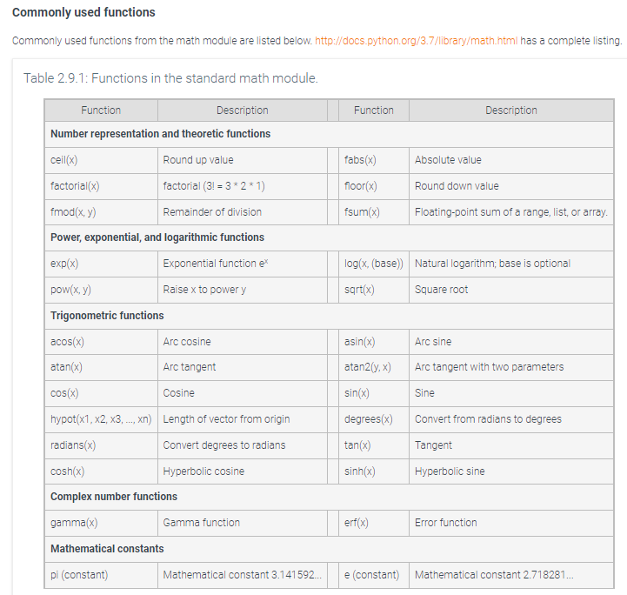
Variables & Expressions
2.9 Math Module
Participation 2.9.1
Challenge Activity 2.9.3

Slide 15
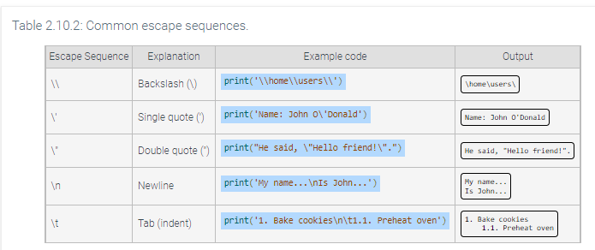
Variables and Expressions
2.10 Representing text
What is Unicode?
String variables represent text, such as the character "G" or the word "pineapple".
What is code point?
Python uses Unicode to represent every possible character as a unique number, known as a code point. For example, the character "G" has the code point decimal value of 71.
What is an escape sequence?
Participation Activity 2.10.2
What is a raw string
Escape sequences can be ignored using a raw string. r’’
What does the function ord() return?
encoded integer value for a string of length one.
What does the function chr() return?
a string of one character for an encoded integer.
Zybooks in class activities

Slide 16
Chapter 3 - Types
3.1 String Basics
What is a sequence type? Is a string = sequence type?
List, String, Tuple, Byte， (string using quotation, is subset)
What is the first character indexed with? 0
What is the notation for an empty string?
An empty string is a sequence type with 0 elements, Ex: my_str = ''.
What does the \ character at the end of string signify?
extends the string to the following line
What does the built-in function len() do?
find the length of a string (and any other sequence type)
What does string indexing mean? Programs commonly access an individual character of a string. As a sequence type, every character in a string has an index, or position, starting at 0 from the leftmost character. A programmer can access a character at a specific index by appending brackets [ ] containing the index
Participation 3.1.4 & 3.1.5
Zybooks in class activities

Slide 17
Chapter 3 - Types
3.1 String Basics
Zybooks in class activities
What does the phrase “strings are immutable” mean?
Writing or altering individual characters of a string variable is not allowed. Strings are immutable objects, meaning that string values cannot change once created.
How do you update a string?
An assignment statement must be used to update an entire string variable.
How do you concatenate a string with another string?
A program can add new characters to the end of a string in a process known as string concatenation. a = “Hello” , b = “World”, a = a + b (Now a = “HelloWorld”)
Participation 3.1.6

Slide 18
Chapter 3 - Types
3.2 list Basics
Zybooks in class activities
What is a container?
A container in Python is an object that can hold other objects. Some examples of containers are lists, tuples, sets, and dictionaries.
What is a list? How is a list designated in Python?
A list is a container created by surrounding a sequence of variables or literals with brackets [ ]. Ex: my_list = [10, 'abc']
What is an element in Python?
A list item is called an element: 10, ‘abc’
How is an element referenced in Python?
An element in Python can be referenced using its index.
What is the 1st element in a list indexed?
0, e.g., my_list[0]

Slide 19
Chapter 3 - Types
3.2 list Basics
Zybooks in class activities
Participation activity 3.2.2
How do you update a list element?
Lists are mutable, meaning that a programmer can change a list's contents. An element can be updated with a new value by performing an assignment to a position in the list.
Participation activity 3.2.5
Are lists mutable or immutable? What does it mean?

Slide 20
Chapter 3 - Types
3.2 list Basics
Zybooks in class activities
What does append() do? Add new elements to a list.
What does pop() do? Removes the element at index i from list.
How do you write the statement to pop the 3rd element from my_list?
my_list.pop(2)
What does remove () do? Removes the first element whose value matches input value.
How do you write the statement to remove the letters ‘abc’ from my_list? Where my_list = [10, ‘abc’, 25]
my_list.remove(‘abc’)
Discuss the sequence type functions in Table 3.2.1

Slide 21
Chapter 3 - Types
3.3 set Basics
Zybooks in class activities
What is the set type?
A set is an unordered collection of unique elements.
What 2 properties do sets have?
Elements are unordered (they do not have a position or index)
Elements are unique (no elements in the set share the same value)
How do you create a set in Python? set(list, tuple, string, etc. auto-remove duplicate)
What is another way to create a set in Python?
nums1 = set([1, 2, 3])
nums2 = {7, 8, 9}
What does num2[2] return? ERROR
Why might we want to use the set type? Sets are implemented as hash tables, which means that they are very efficient for lookup operations.
Participation Activity 3.3.1

Slide 22
Chapter 3 - Types
3.3 set Basics
Zybooks in class activities
What does the method add() do? Places a new element into the set if the set does not contain an element with the provided value
What does the method remove() do? Remove a specific element from the set.
What does the method pop() do? Randomly remove an element from the set.
Discuss the different methods that can be performed on sets in Table 3.3.1
What are common set theory operations? Intersection, union, difference, symmetric_difference
Review common set theory operations in Table 3.3.2
Participation activity 3.3.5

Slide 23
Chapter 3 - Types
3.4 dictionary Basics
What is a Python dictionary type?
Represented by the dict object type
Associates (or maps) keys with values -> key:value pairs
Example: players = {‘dog’ : 1, ‘cat’: 3}
Participation 3.4.1
Can dictionary entries be accessed by indexing? Yes, dictionary_name[index]
How are dictionary entries accessed? Specifying in brackets, dic[“key”]
What is the Python syntax to access a dictionary entry?
prices = {‘apples’: 1.99, ‘oranges’: 1.49}
How do you access the price of an apple? prices[‘apple’]
What is a KeyError? Runtime error when no entry with a matching key exists in the dictionary
Zybooks in class activities

Slide 24
Chapter 3 - Types
3.4 dictionary Basics
Zybooks in class activities
Can dictionary entries be added, modified, or deleted?
Yes, dict[k] = v, del dict[k] = v
Refer to the discussion on how to add, modify or delete an item from a dictionary
Participation Activity 3.4.3
Give an example of when you might want to use the dictionary type?

Slide 25
Chapter 3 - Types
3.5 Types summary
Zybooks in class activities
Name 2 types of numeric Python types
Give 2 examples of sequence types that we have discussed
String, list
Are sequence types indexed? What position does the first index start with?
What types can lists contain?
What types can a string contain?
What is a mapping type in Python? dict
How are elements in a Python dict type indexed? Using strings

Slide 26
Chapter 3 - Types
3.5 types summary
Zybooks in class activities
Participation Activity 3.5.1
Participation Activity 3.5.2
Participation Activity 3.5.3

Slide 27
Wrapping Up Module 4

Slide 28
Chapter 3 - Types
3.6 Grade Calculation
Zybooks in class activities
Let’s walk thru the Grade calculator as given in zyDE 3.6.1
Working in your table group, complete exercise 1 (4-5 minutes)
Need a volunteer to share their work with the class
Working in your table group, complete exercise 2 (4-5 minutes)
Need a volunteer to share their work with the class
Working in your table group, complete exercise 3 (4-5 minutes)
Need a volunteer to share their work with the class

Slide 29
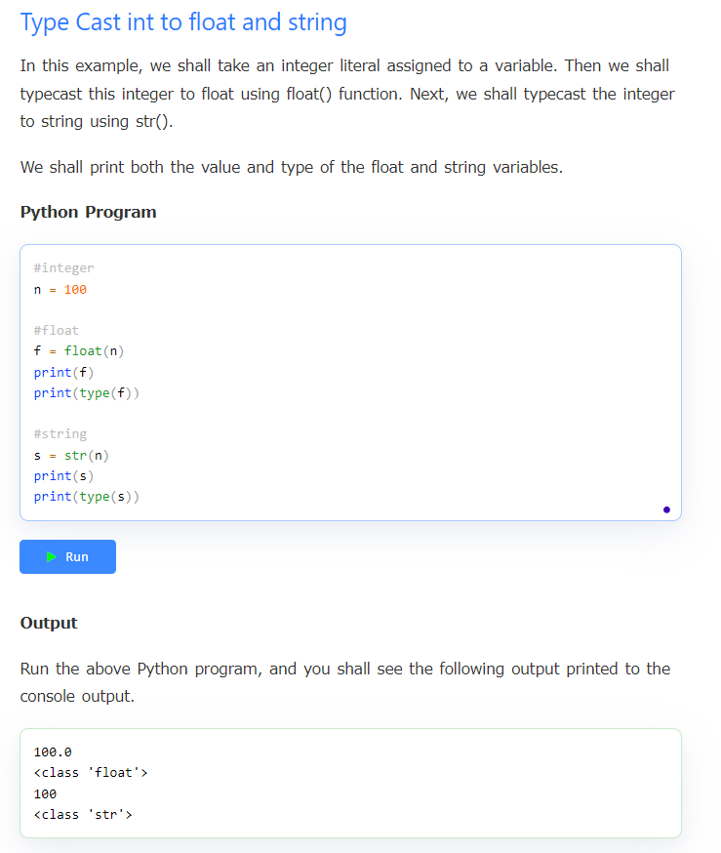
Chapter 3 - Types
3.7 type conversions
Zybooks in class activities
Participation Activity 3.7.2
What is type casting?

Slide 30
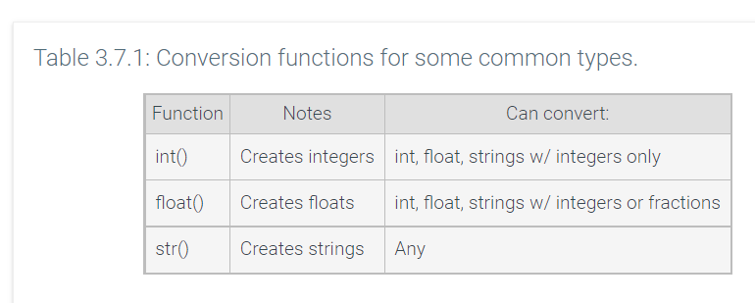
Chapter 3 - Types
3.7 Type conversions
Zybooks in class activities
What does the term type conversion mean?
What is an implicit conversion? An implicit conversion is a type conversion automatically made by the interpreter, usually between numeric types.
Participation Activity 3.7.1
What is an explicit conversion and when might we want to do this?

Slide 31
Chapter 3 - Types
3.7 type conversions
Zybooks in class activities
Participation Activity 3.7.2
What is type casting?
Challenge Activity 3.7.3

Slide 32
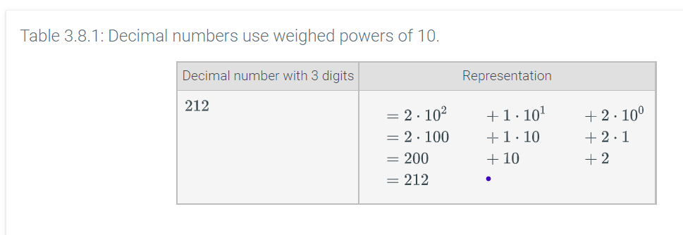
Chapter 3 - Types
3.8 binary numbers
Zybooks in class activities
What ‘base’ does the average programmer / person use to refer to numbers?
What ‘base’ does a computer use?
What is a binary number?
What is the typical size (in number of bits) of a Python variable? 32/64

Slide 33
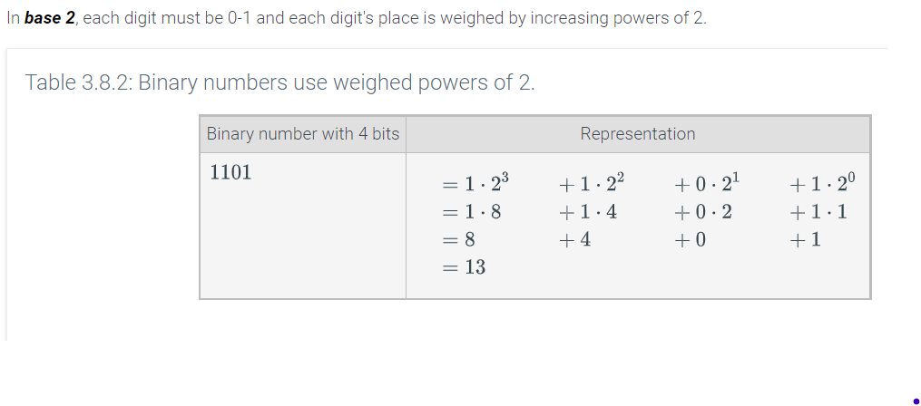
Chapter 3 - Types
3.8 binary numbers
Zybooks in class activities
Participation Activity 3.8.1
Participation Activity 3.8.2

Slide 34
Chapter 3 - Types
3.9 string formatting
What is a formatted string literal?
How is a formatted string literal denoted in Python?
An f-string starts with a ‘f’ character before the starting quote and uses curly braces {} to denote the placeholder expression
See Participation Activity 3.9.1
Participation Activity 3.9.2
Discuss the “Additional f-string features” section of the book
Participation Activity 3.9.3
What is a format specification? A format specification inside a replacement field allows a value's formatting in the string to be customized.
What is a presentation type?
Review Table 3.9.2
Participation Activity 3.9.4
Zybooks in class activities

Slide 35
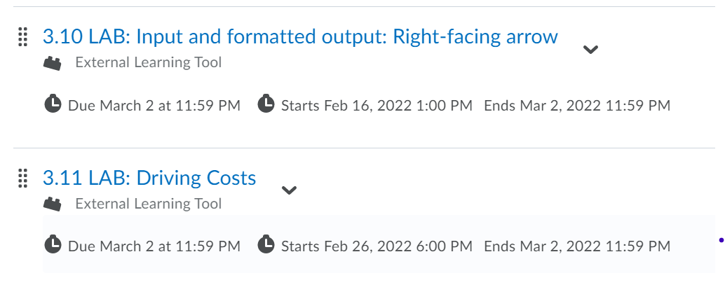
Chapter 3 - Types
Labs 3.10 and 3.11
Zybooks in class activities
We are starting Module 5 on Wed, 3/2!!!
Get all the Participation Activities in Chapters 1, 2, 3 completed by midnight 3/1

Slide 36
Chapter 4 - Strings
4.1 string SLICing
Strings are a sequence type: Index
web = ‘www.google.com’ web[6] = ‘o’
String[start:end] create new string from start to end -1, web[2:7] = “w.goo” [left included, right excluded]
Negative numbers: web[-1] = ‘m’ web[-3] = ‘c’
web[-4:] = ‘.com’ web[-4:-1] = ‘.co’
web[:5] = ‘www.g’ web[:-5] = ‘www.googl’
web[2:1] = ‘’ web[2:2] = ‘’
The Python interpreter creates a new string object for the slice.
Slice stride [x,y,z], z default to 1 if not specified.
web[::2] = ‘wwgol.o’
Zybooks in class activities

Slide 37
Chapter 4 - Strings
4.2 ADVANCED string FORMATTING
All about the format of print()
A format specification may include a field width that defines the minimum number of characters that must be inserted into the string.
{x:5} to specifying a string of 5 characters (0-4)
print(f’{“Test":6} ‘) “Test ”
print (“|” * 3) “|||”
Aligning text
left-aligned (<), right-aligned (>) and centered (^). Numbers will be right-aligned within the width by default, whereas most other types like strings will be left-aligned. Check 4.2.2
Fill Check Table 4.2.1, 4.2.4
Float point precision: f'{1.725:.1f}’ f'{1.5:.3f}’ f'{1.666:.2f}'
Zybooks in class activities

Slide 38
Chapter 4 - Strings
4.3 string METHODS
String objects have many useful methods to do things like replacing characters, converting to lowercase, capitalizing the first character, etc.
Recall that string objects are immutable—once created, strings can not be changed. To update a string variable, a new string object must be created and bound to the variable name, replacing the old object.
replace(old, new) replace all
replace(old, new, count) replace certain count
find(x) find(x, start) find(x, start, end) rfind(x) count(x)
String objects may be compared using relational operators (<, <=, >, >=), equality operators (==, !=), membership operators (in, not in), and identity operators (is, is not). Table 4.3.1
isalnum(), isdigit(), islower(), isupper(), isspace(), startswith(x), endswith(x)
capitalize(), lower(), upper(), strip(), title()
Zybooks in class activities

Slide 39
Chapter 4 - Strings
4.4 string SPLIT and JOIN
split()
The string method split() splits a string into a list of tokens. Each token is a substring that forms a part of a larger string. A separator is a character or sequence of characters that indicates where to split the string into tokens.
'Martin Luther King Jr.'.split() = ['Martin', 'Luther', 'King', 'Jr.’]
join()
joining a list of strings together to create a single string.
my_str = '@'.join(['billgates', 'microsoft']) assigns my_str with the string 'billgates@microsoft’
my_str = ''.join(['billgates', 'microsoft']) assigns my_str with the string 'billgates Microsoft’
Zybooks in class activities

